Slide 1

SNOWFLAKE INTRODUCTION
By: Vishal Kaushal

Slide 2
AGENDA
Datawarehouse Introduction
OLAP vs OLTP
Traditional Big data challenges
Snowflake Introduction
Why Snowflake ?
Snowflake vs Big Query vs RedShift
Key features
Architecture
Functional Architecture
Query Execution flow

Slide 3
INTRODUCTION
I HAVE 10YRS of EXP in Data engineering Domain, Working as a Solution Architect now. Worked on SQL,ETL,DATA WAREHOUSE, DATA MODELLING,TABLEAU,POWER BI, SNOWFLAKE, MATILLION, PYTHON, AWS, HIVE, SPARK etc.
Trained more than 1000 Professionals in Snowflake, Matillion & SQL.

Slide 4
Traditional Datawarehouse Challenges:
IAAS : Data Warehouse was all about infrastructure-as-a-service (IaaS).
Limited Storage Capacity: Although it has storage arrays to store the data, but archival is needed after specific period. This is not acceptable in today’s world as Scientist use this data for real time.
High Cost: More storage disk trade off with high cost.
Limited Processing Capability: The process time is more because of Single Core machine or limited infrastructure.
No Scalability: As data grows, the systems should be scalable enough to store it. However, conventional databases are not capable to handle such enormous data.
Failover & Replication : Aging hardware and hardware failures.
Data Security: Data is available from numerous sources which leads to potential security problems and giving hackers a chance to move in.

Slide 5
Snowflake Introduction
Snowflake is a true SaaS offering. More specifically:
There is no hardware (virtual or physical) to select, install, configure, or manage.
There is virtually no software to install, configure, or manage.
Ongoing maintenance, management, upgrades, and tuning are handled by Snowflake.
Snowflake runs completely on cloud infrastructure. All components of Snowflake’s service (other than optional command line clients, drivers, and connectors), run in public cloud infrastructures.
Snowflake uses virtual compute instances for its compute needs and a storage service for persistent storage of data. Snowflake cannot be run on private cloud infrastructures (on-premises or hosted).
Snowflake is not a packaged software offering that can be installed by a user. Snowflake manages all aspects of software installation and updates

Slide 6
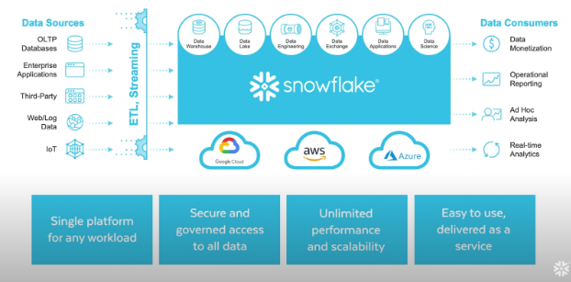
Snowflake flow

Slide 7
Snowflake Advantages over on-Prem
True SAAS ,Hassle free Account setup
Scalability
Availability and Security
FAST DATA Retrieval
Flexible Charges (Pay as you go).
Zero Management /Maintenance
Cloud Native Advantages
Seamless collaboration or Data Sharing
Near Zero Downtime
Time travel and Fail safe

Slide 8
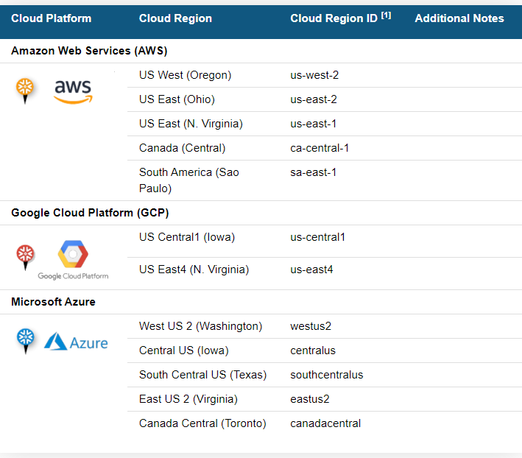
Introduction to Snowflake
Snowflake’s Data Cloud is powered by an advanced data platform provided as Software-as-a-Service (SaaS).
Snowflake enables data storage, processing, and analytic solutions that are faster, easier to use, and far more flexible than traditional offerings.
Main cloud providers , AWS, GCP & AZURE
Regions are
1- North & South America
2- Europe & Middle East Regions
3-Asia Pacific Regions

Slide 9
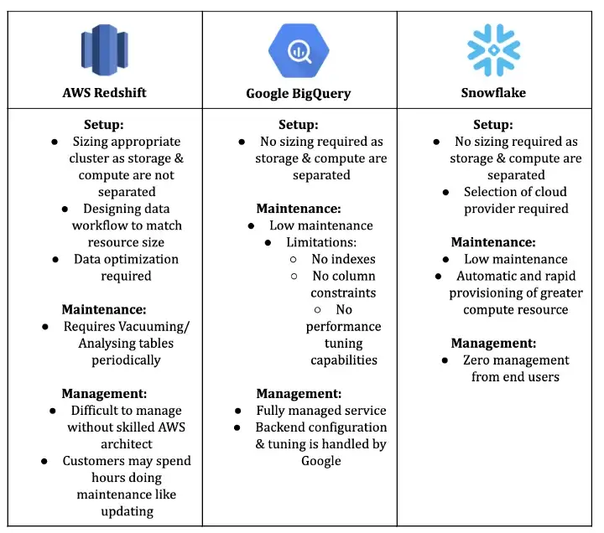

Slide 10
WHEN TO USE WHICH TOOL
1) Redshift
Best applied to scenarios that require constant computation for example:
a) NASDAQ daily reporting: Time-sensitive workload for data reporting
b) Automated ad-bidding: Bids across certain ad networks are adjusted via predictive models on top of Redshift on a near real-time basis
c) Live dashboards: Having live data streaming with continuous querying via refreshing
2) Big Query
Best applied to scenarios with spiky workloads (i.e. you’re running lots of queries occasionally, with high idle time) for example:
a) Recommendation models: That run once a day for ECommerce applications
b) Ad-hoc reporting: Occasion complex queries for a quarterly report
c) Sales intelligence: for sales or marketing teams to make ad-hoc discovery via analysing the data in any way they wish
d) Machine learning: to discover new patterns in the data especially consumer behaviour
3) Snowflake
Best applied to steadier, more continuous usage pattern but requires constant upscaling & downscaling, for example:
a) Business Intelligence companies: Many concurrent users (100s to 1,000s) querying the data at the same time to discover a pattern in the data
b) Providing data as a service: Giving thousands of client access to your data for analysis purposes in the form of an analytics user interface or data APIs

Slide 11
Note : …..
Ultimately, in the world of cloud-based data warehouses, Redshift, Big Query and Snowflake are similar in that they provide the scale and cost savings of a cloud solution. The main difference you will likely want to consider is the way that the services are billed, especially in terms of how this billing style will work out with your style of workflow. If you have very large data, but a spiky workload (i.e. you’re running lots of queries occasionally, with high idle time), Big Query will probably be cheaper and easier for you. If you have a steadier, more continuous usage pattern when it comes to queries and the data you’re working with, it may be more cost-effective to go with Snowflake, since you’ll be able to cram more queries into the hours you’re paying for. Or if you have system engineers to tune the infrastructure according to your needs Redshift might just give you the flexibility to do so.

Slide 12
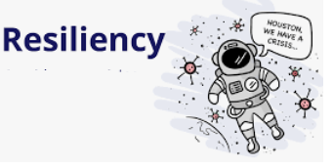
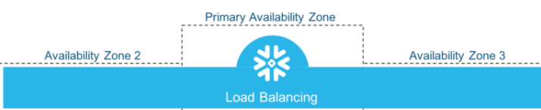
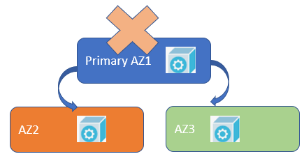
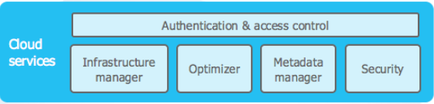
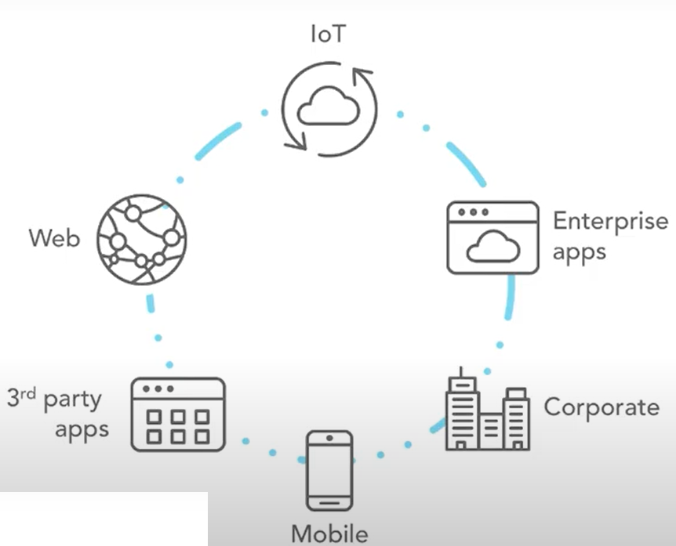
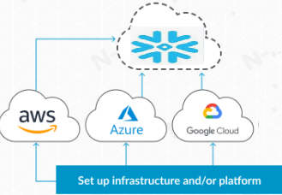
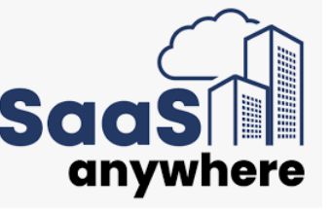
Why Snowflake:
Elastic in Nature.
Snowflake assures High Availability.
Providing flexibility of big data platforms.
No need to worry about Infrastructure and Security.
Assures query resiliency in case of VW failures.
Automatic reprovision of Impacted VW in another AZ.
Automatically handle Admin and metadata operations.
Cloud agnostic in nature.
Eliminate Overbuy
Auto Scaleup and down
No advance Capacity plan

Slide 13

What makes Snowflake Data Warehouse unique..
PAY PER USAGE
OPTMIZED STORAGE
CACHING
CLONING
Not need to pay for availability
Increase Market share
Lower costs and more transparency
Columnar DB
Large Block Size 16 MB
Automatically Manage Statistics
Compressed
Data Cache/Remote Cache
Result Cache
Metadata Cache
Point in Time Snapshot of Table/DB/Schema
No Storage unless change
Create Instant Backup
NATIVE SUPPORT SEMISTRUCTURE
REPLICATION
Deploy on any cloud and regions,
Disaster Management and Business Continuity,
Global replication for HA
Ingest and immediately query JSON, Parquet, Avro, ORC, and XML without defining schemas in advance
TIME TRAVEL &
FAIL SAFE
SHARING
SERVERLESS
Easily access historical data after it has been modified or deleted for periods up to 90 days.
Revert Data after Retention is over
Snowpipe
Automatic Clustering
Materialized View Maint
Serverless Task
Search Optimization
Share live data easily and securely
No DataCopy or Movement
Sharing with Non licensed Snowflake Customer

Slide 14
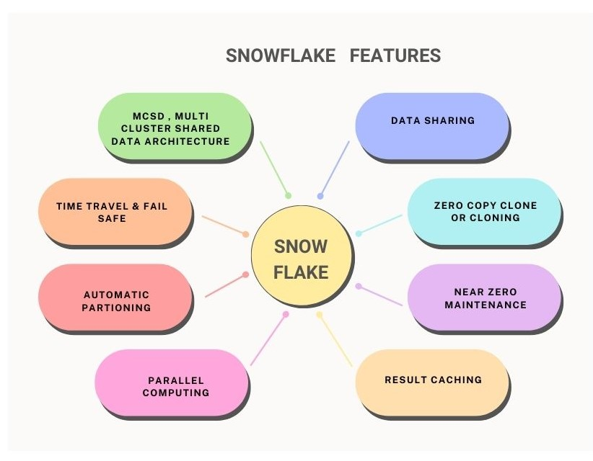
SNOWFLAKE FEATURES

Slide 15
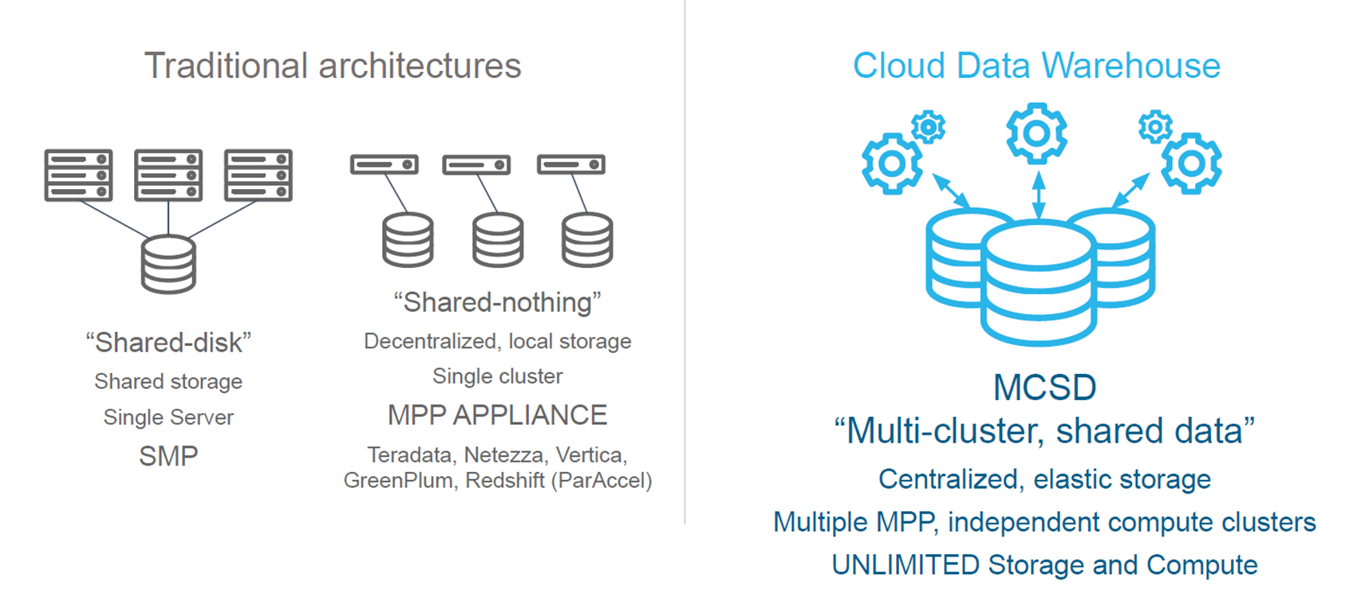
CLOUD DATA WAREHOUSE
Notes:
In a cluster, each machine is largely independent of the others in terms of memory, disk, etc.
They are interconnected using some variation on normal networking.
The cluster exists mostly in the mind of the programmer and how s/he chooses to distribute the work.
In a Massively Parallel Processor, there really is only one machine with thousands of CPUs tightly interconnected.
MPPs have exotic memory architectures to allow extremely high speed exchange of intermediate results with neighboring processors.

Slide 16
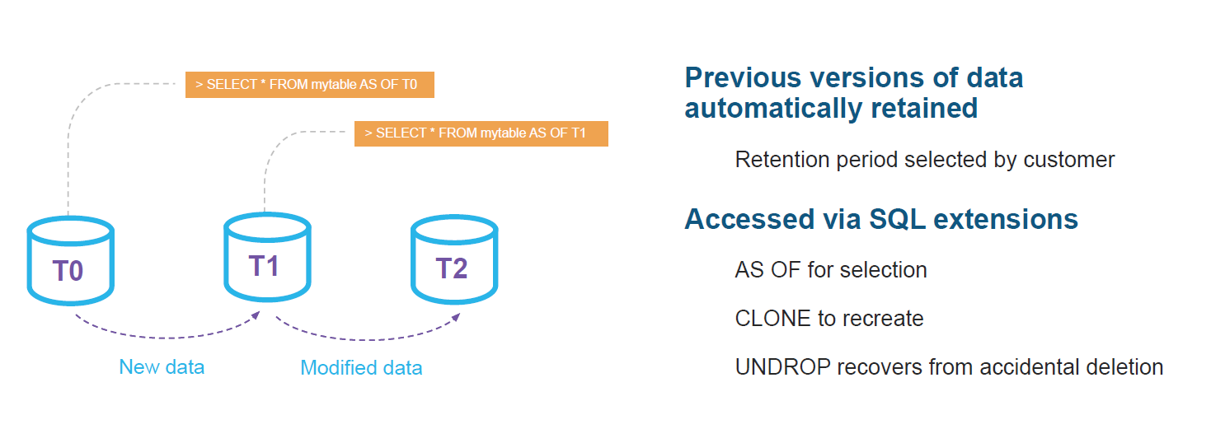
Snowflake: Time Travel
Notes:
Snowflake Time Travel enables accessing historical data (i.e. data that has been changed or deleted) at any point within a defined period. It serves as a powerful tool for performing the following tasks: ... Duplicating and backing up data from key points in the past

Slide 17
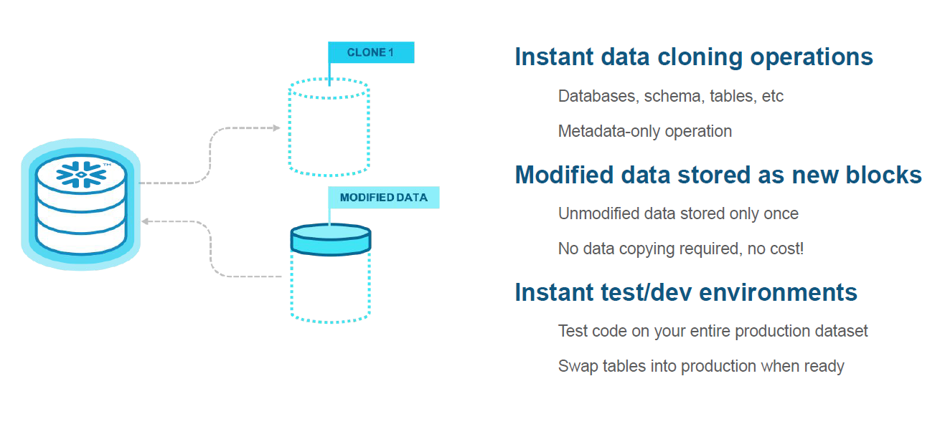
Snowflake: Zero Copy Clone
Notes:
Zero copy cloning is a snowflake implementation where a simple keyword CLONE lets you create copy of your tables, schemas, databases without copying the actual data. So, you can have almost real time data from production cloned into your dev and stage environments to be able to perform various actions.

Slide 18
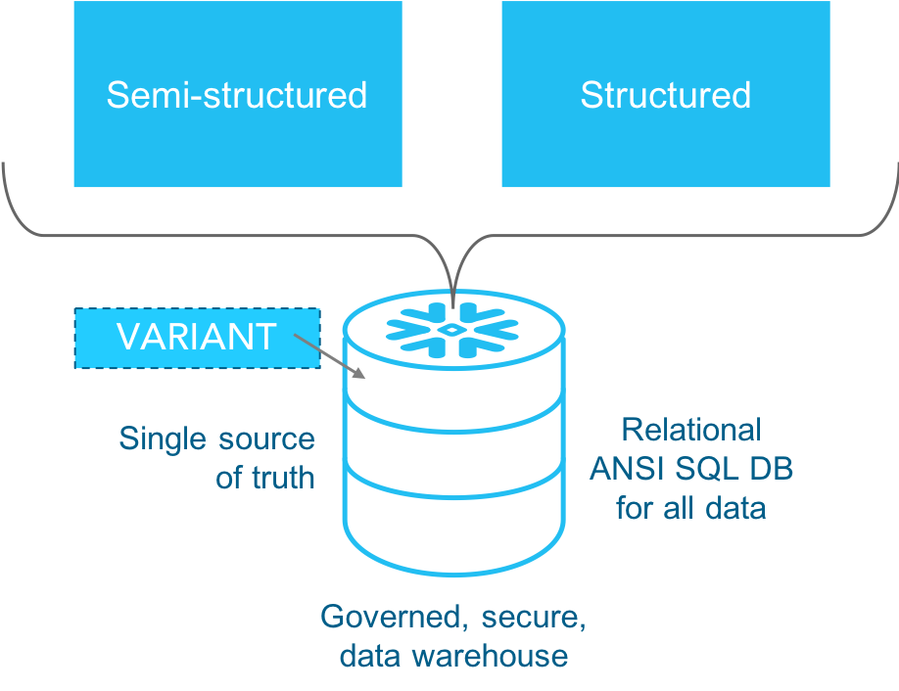
Ease to handle the Semi and Structured Data
Notes:
With the help of VARIANT data type, Snowflake loads semi-structured data as a VARIANT data type, enabling you to quickly query JSON in a fully relational manner.

Slide 19
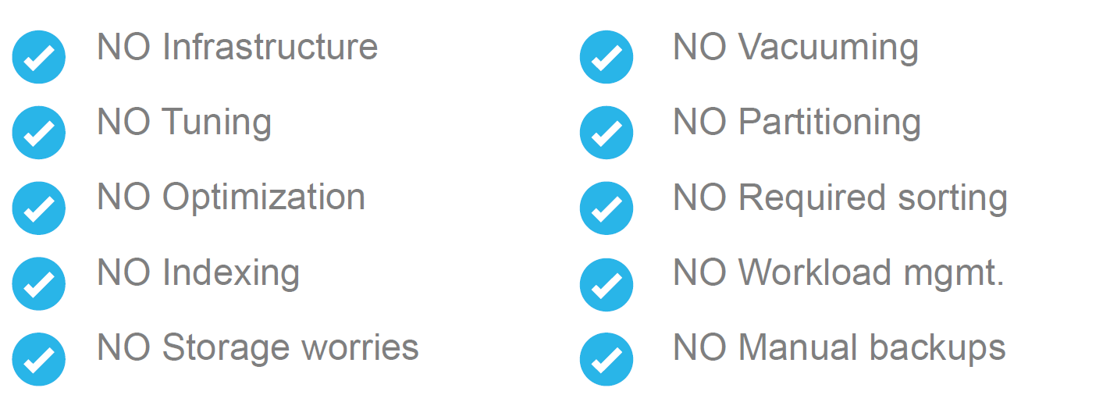
Snowflake: Near Zero Management

Slide 20
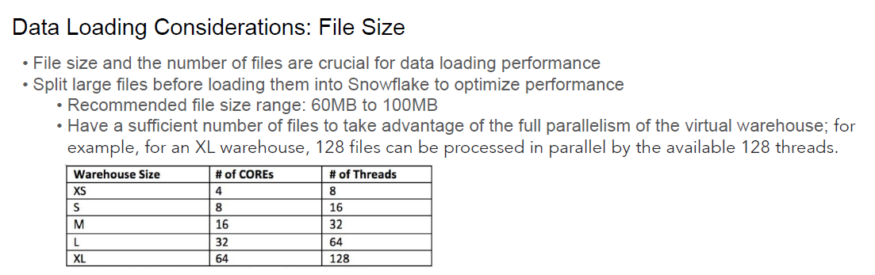
Data Warehouse size

Slide 21
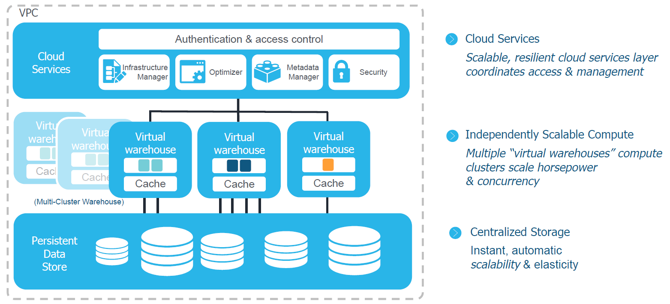
Snowflake Architecture
Notes:
Storage – blob storage based on S3 (AWS) proprietary format but using many ideas from Hadoop
Cloud Services – managed on our behalf, Meta Data and Optimizer are key
Compute – independent from Storage can scale separately, with Meta Data and Storage architecture Cache is key – especially for Reporting

Slide 22
Cloud Service Layer
Snowflake cloud services layer is a collection of services that coordinate activities such as authentication, access control and encryption.
It also includes management functions for handling infrastructure
and metadata, as well as performing query parsing and optimization, among other
features. This global services layer is sometimes referred to as the Snowflake “brain”
because all the various service layer components work together to handle user
requests that begin from the time a user requests to log in.
The cloud services layer manages data security including the security for data sharing. The Snowflake cloud services layer runs across multiple availability zones in each
cloud provider region and holds the results cache, a cached copy of the executed
query results. The metadata required for query optimization or data filtering are also
stored in the cloud services layer

Slide 23
Query Processing or Compute Layer
A Snowflake compute cluster, most often referred to simply as a “virtual warehouse,”
is a dynamic cluster of compute resources consisting of CPU memory and temporary
storage. Creating virtual warehouses in Snowflake makes use of the compute clusters,
virtual machines in the cloud, which are provisioned behind the scenes. Snowflake
doesn’t publish the exact server in use at any given time; it could change as the cloud
providers modify their services. The Snowflake compute resources are created and
deployed on-demand anytime to a Snowflake user, such as yourself, for whom the
process is transparent.
Snowflake’s unique architecture allows for separation of storage and compute which
means any virtual warehouse can access the same data as another, without any con‐
tention or impact on performance of the other warehouses.

Slide 24
Data Storage Layer
Centralized (Hybrid-Columnar) Database Storage Layer
Snowflake’s centralized database storage layer holds all data, including structured and
semi-structured data. As data is loaded into Snowflake, it is optimally reorganized
into a compressed, columnar format and stored and maintained in Snowflake data‐
bases. Each Snowflake database consists of one or more schemas, which is a logical
grouping of database objects such as tables and views.
Snowflake automatically organizes stored data into micro-partitions, an optimized immutable com‐
pressed columnar format, which is encrypted using AES-256 encryption. Snowflake
optimizes and compresses data to make metadata extraction and query processing
easier and more efficient.
There are two unique features in the storage layer architecture – time travel and zerocopy cloning

Slide 25
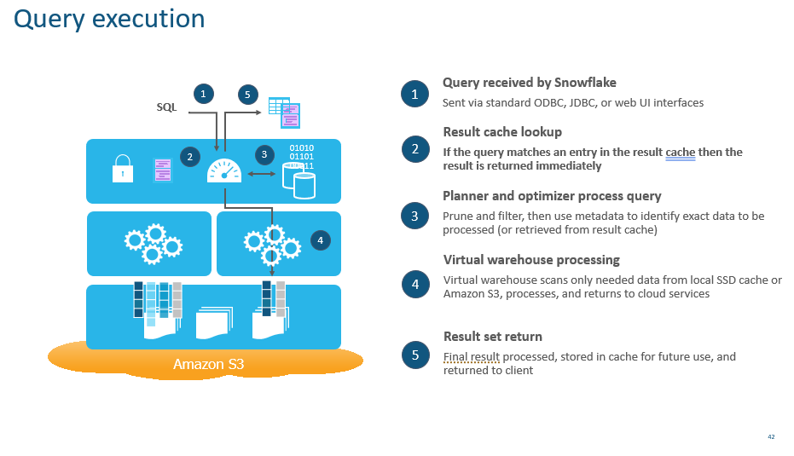
Query Execution Flow

Slide 26
Important Links
Account Creation : https://www.snowflake.com/en/
Pricing : https://www.snowflake.com/pricing/
Snowflake Architecture : https://docs.snowflake.com/en/user-guide/intro-key-concepts

Slide 27

THANK YOU

